Slide 1


Pasco County Audrey Nelson Award 2026
Urgent Care Center
NCDA Legislative Conference
February 6, 2026
Cathy Pearson
Assistant County Administrator –
Public Services
Mari Thieryung
Community Development Director
Hilary Bruno
Community Development Manager
Tracey Kaly
Director of Operations BayCare
John Learn
Manager, Federal Government Relations
BayCare

Slide 2


Mission Statement
Improving the lives of Pasco’s citizens through homeless initiatives, neighborhood revitalization, affordable housing and community partnerships using state and federal funding.
BayCare Health System will improve the health of all we serve through community-owned services that set the standard for high-quality, compassionate care.

Slide 3
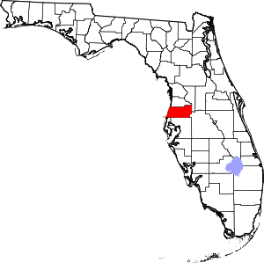
About Pasco County, FL
Population – 660,000 (just over 247,000 households)
Location – north of Tampa, FL on the Gulf of Mexico
Square Miles – 747
Owner-occupied/rental housing – 75/25%
LMI – 40% LMI, 48% Cost Burdened
CDBG - $3.1 million
HOME - $1.1 million
ESG - $272,000
ESG-RUSH - $834,000

Slide 4
The Need
The Opioid Crisis
The scope of the problem is HUGE –
2021 Pasco and Pinellas Counties reported the highest number of fentanyl deaths in Florida
Overdose rates historically above state and national averages
Pasco County Sheriff’s Office reports more than 100 overdoses per month – 1:5 are fatal
Mental Health Needs
Over 31% of ESG recipients from 2024-2025 reported a significant mental illness
Many people are hesitant to self-report substance abuse in the homeless arena
Anecdotally, the Holiday, Florida area is considered one of the nation’s opioid hot spots

Slide 5
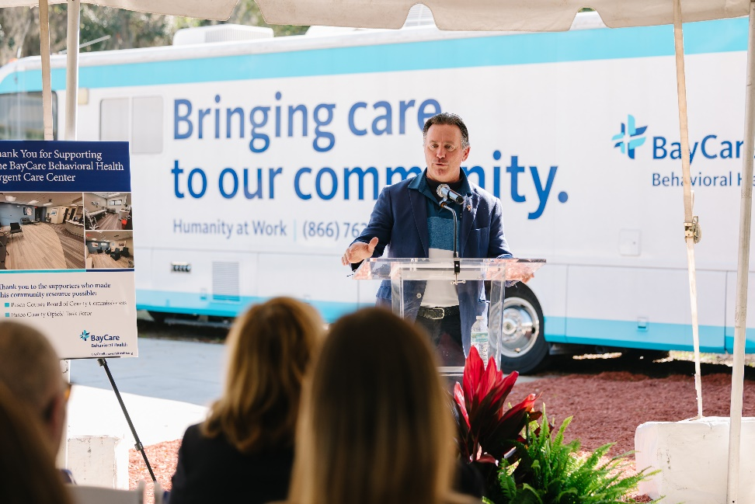
National Objective
This activity meets the National Objective of benefiting low- and moderate- income persons.

Slide 6
Total Project Costs:
Infrastructure and Renovations:
  CDBG $1,469,927
  Opioid Treatment, Prevention and Recovery Fund
  $484,753
TOTAL: $1,954,690
Operations*:
  Opioid Treatment, Prevention and Recovery Fund
  $3,086,783
  HHS Certified Community Behavioral Health Center
    $3,994,609
    *supporting operations years 1-4 = sustainability

Slide 7
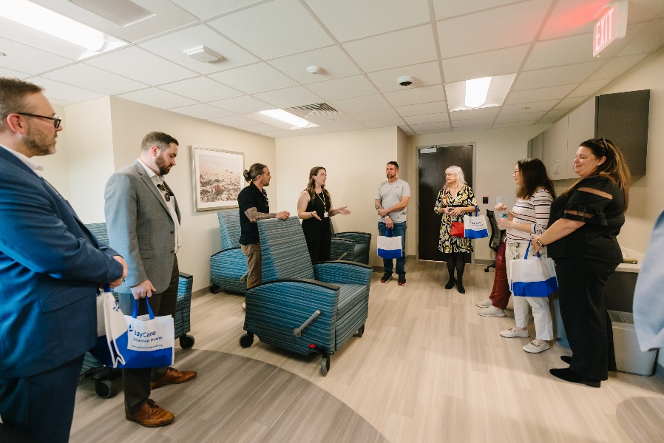
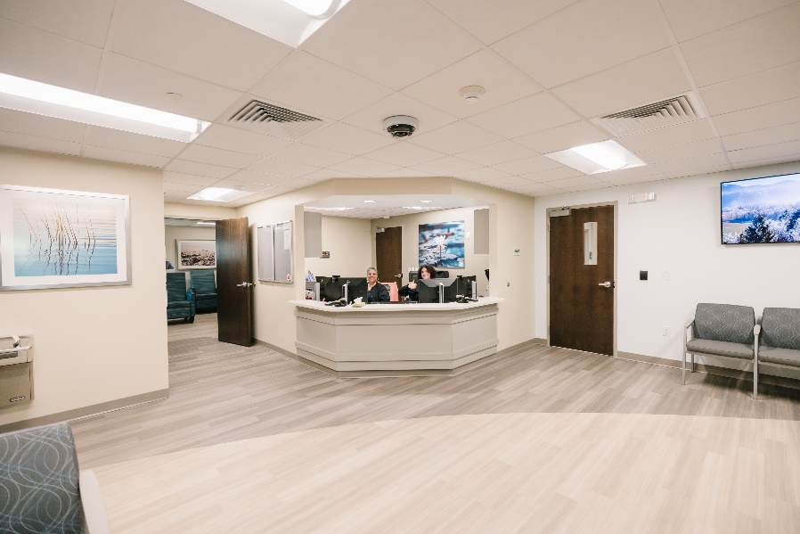
Description:
CDBG funds were used for infrastructure and renovations to an existing BayCare building
Focuses on walk-in and virtual behavioral health urgent care services with extended hours
Immediate access to services
Outpatient care with extended hours
Another option other than Emergency Room
Voluntary walk in and hybrid services
Located on the Pasco Campus which includes a full continuum crisis hub including CSU

Slide 8
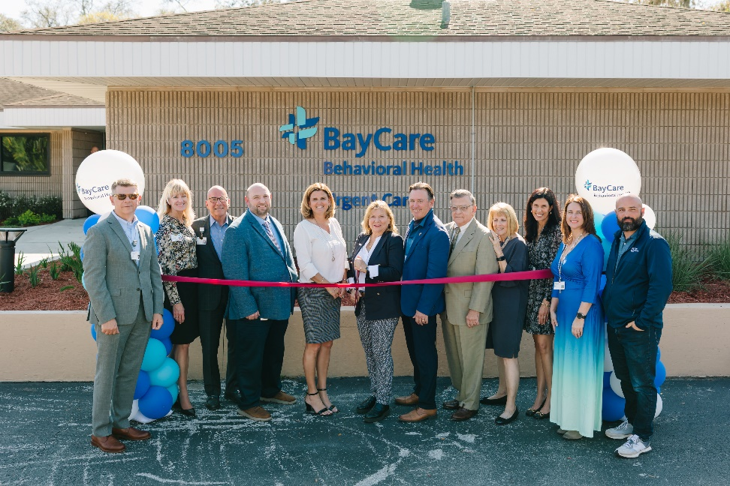
Local Impact (opened February 2025)
Establishes a full continuum of crisis services available to Pasco County residents
Addresses the high-priority access needs of vulnerable populations by providing rapid access for urgent mental health and addiction issues
Goal – 450 in first year
Reality – 1600 in first eleven months
94% of those served were diverted from higher levels of care
71% of follow up appointments were attended from critical transition points (Inpatient psychiatric, detoxification, jail, law enforcements, etc. (previously only 34% of these appointments attended.

Slide 9
Innovation:
This is the FIRST Behavioral Urgent Care Center in the State of Florida
The UCC is a forward-thinking service offering Pasco County residents a timely alternative to traditional hospital emergency rooms and inpatient crisis units
Leveraging funds and creatively bundling of funds to renovate the building and create ongoing sustainability
The UCC provides urgent, unscheduled support for mental health and additional concerns through walk-in outpatient care for assessment and fast access to behavioral health treatment

Slide 10
Collaboration
CDBG funds were the first funds committed to this project.
The CDBG funds were like a magnet – other funds (Opioid and prevention funds) followed
Strategic collaboration between stakeholders created new partnerships
Design and renovations began 11/24, first clients 2/25
Stakeholders:
  Law enforcement
  Department of Health
  County Representatives
  Opioid Task Force
  MH and SA Practitioners
  Individuals with lived experience

Slide 11
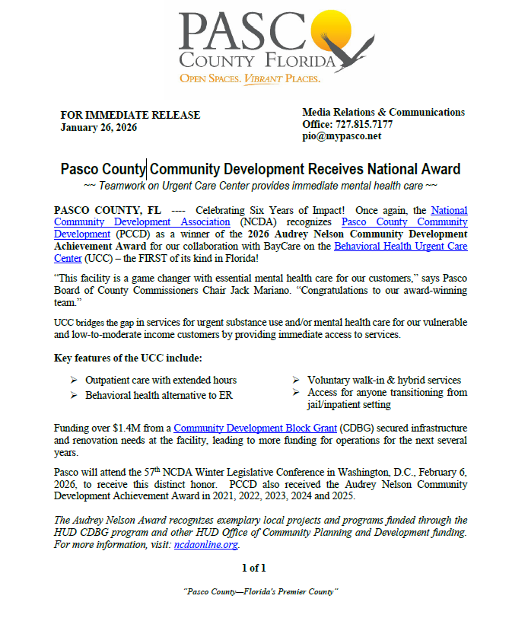
Press Release

Slide 12


